Slide 1


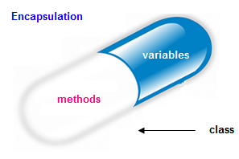

Encapsulation and Validation
Private Fields, Encapsulation, Validation, Benefits
C# OOP
Intro
SoftUni Team
Technical Trainers
Software University
http://softuni.bg

Slide 2


Table of Contents
Class Fields and Properties
What is Encapsulation?
The this Keyword
Access Modifiers
Validation
Mutable and Immutable Objects

Slide 3
Questions
sli.do #CSharpDB

Slide 4

Class Fields and Properties

Slide 5
Fields
Variables that belong to the class
Have a type and name
class Dice
{
string type;
int sides;
int[] rollHistory;
Person owner;
…
}
Fields can be of any type

Slide 6
Access Modifiers
Both classes and class members have access modifiers
Modifiers define visibility to other classes
public class Dice
{
private int sides;
public void Roll(int amount) { … }
}
Class access modifier
Fields should always be private!
Member access modifier

Slide 7
Properties
Used to create accessors and mutators (getters and setters)
class Dice
{
private int sides;
public int Sides
{
get { return this.sides; }
set { this.sides = value; }
}
}
Hidden to the outside world
Provides access to the field
Modifies the field’s value

Slide 8

Encapsulation
Hiding Implementation

Slide 9


Encapsulation
Process of wrapping code and data together into a single unit
Class fields must be private
Use getters and setters for data access
private int age;
public int Age
{
get { return this.age; }
set { this.age = value; }
}
Notes:
Encapsulation hides the implementation details
Class announces only a few operations (methods) available for its clients – its public interface
All data members (fields) of a class should be hidden
Accessed via properties (read-only and read-write)
No interface members should be hidden
Encapsulation == hide (encapsulate) data behind constructors and properties

Slide 10
Encapsulation – Example
Fields should be private
Person
-name: string
-age: int
+Person(string name, int age)
+Name: string
+Age: int
Notes:
Fields are private
Constructors and accessors are defined (getters and setters)

Slide 11
The this Keyword
this is a reference to the current object
this can be passed like an argument in a method or a constructor call
this can be returned from a method
private string name;
public Person(string name)
{
this.name = name;
}
Notes:
Constructors are declared public
Constructors perform checks to keep the object state valid
Interface methods are always public
Not explicitly declared with public
Non-interface methods are declared private / protected

Slide 12
The this Keyword (2)
this can invoke a method of the current class
private string FirstName { get { return this.firstName } }
private string LastName { get { return this.lastName } }
public string FullName
{
return this.FirstName + " " + this.LastName
}
Notes:
Constructors are declared public
Constructors perform checks to keep the object state valid
Interface methods are always public
Not explicitly declared with public
Non-interface methods are declared private / protected

Slide 13
The this Keyword (3)
this can invoke a constructor of the current class
public Person(string firstName, string lastName)
{
this.firstName = firstName;
this.lastName = lastName;
}
public Person (string firstName, string lastName, int age)
: this (firstName, lastName);
{
this.age = age;
}
Notes:
Constructors are declared public
Constructors perform checks to keep the object state valid
Interface methods are always public
Not explicitly declared with public
Non-interface methods are declared private / protected

Slide 14

Access Modifiers
Visibility of Class Members

Slide 15
Public Access Modifier
Anything declared inside a public class can be accessed by any class belonging to the .NET World
We can use using statements to access a public class in a different namespace
The Main() method has to be public
public class Person
{
public string Name { get; set; }
public int Age { get; set; }
}
Notes:
Access Level "public"
When we use the modifier public in front of some element, we are telling the compiler, that this element can be accessed from every class, no matter from the current project (assembly), from the current package. The access level public defines the miss of restrictions regarding the visibility. This access level is the least restricted access level in Java.
Access Level "private"
The access level private is the one, which defines the most restrictive level of visibility of the class and its elements. The modifier private is used to indicate, that the element, to which is issued, cannot be accessed from any other class (except the class, in which it is defined), even if this class exists in the same package.
Access Level “protected"
The access level private is the one, which defines the most restrictive level of visibility of the class and its elements. The modifier private is used to indicate, that the element, to which is issued, cannot be accessed from any other class (except the class, in which it is defined), even if this class exists in the same namespace.
Access Level “default"
This is the default access level, i.e. it is used when there is no access level modifier in front of the respective element of a class. Members can be accessed only from the same package.

Slide 16
Private Access Modifier
The main way to encapsulate an object and hide its data from the outside world
Classes and interfaces cannot be private
Can only be accessed within the class itself
private string name;
public Person (string name)
{
this.name = name;
}
Notes:
Access Level "public"
When we use the modifier public in front of some element, we are telling the compiler, that this element can be accessed from every class, no matter from the current project (assembly), from the current package. The access level public defines the miss of restrictions regarding the visibility. This access level is the least restricted access level in Java.
Access Level "private"
The access level private is the one, which defines the most restrictive level of visibility of the class and its elements. The modifier private is used to indicate, that the element, to which is issued, cannot be accessed from any other class (except the class, in which it is defined), even if this class exists in the same package.
Access Level “protected"
The access level private is the one, which defines the most restrictive level of visibility of the class and its elements. The modifier private is used to indicate, that the element, to which is issued, cannot be accessed from any other class (except the class, in which it is defined), even if this class exists in the same namespace.
Access Level “default"
This is the default access level, i.e. it is used when there is no access level modifier in front of the respective element of a class. Members can be accessed only from the same package.

Slide 17
Internal Access Modifier
internal is the default modifier in C#
Available to any other class in the same project (assembly)
class Person
{
string Name { get; set; }
internal int Age { get; set; }
}
Team rm = new Team("Real");
rm.Name = "Real Madrid";
Notes:
Access Level "public"
When we use the modifier public in front of some element, we are telling the compiler, that this element can be accessed from every class, no matter from the current project (assembly), from the current package. The access level public defines the miss of restrictions regarding the visibility. This access level is the least restricted access level in Java.
Access Level "private"
The access level private is the one, which defines the most restrictive level of visibility of the class and its elements. The modifier private is used to indicate, that the element, to which is issued, cannot be accessed from any other class (except the class, in which it is defined), even if this class exists in the same package.
Access Level “protected"
The access level private is the one, which defines the most restrictive level of visibility of the class and its elements. The modifier private is used to indicate, that the element, to which is issued, cannot be accessed from any other class (except the class, in which it is defined), even if this class exists in the same namespace.
Access Level “default"
This is the default access level, i.e. it is used when there is no access level modifier in front of the respective element of a class. Members can be accessed only from the same package.

Slide 18
Protected Access Modifier
Can only be accessed by inherited classes
The protected access modifier cannot be applied to classes and interfaces
Prevents an unrelated class from using it
class Person
{
protected string FullName { get; set; }
}
Notes:
Access Level "public"
When we use the modifier public in front of some element, we are telling the compiler, that this element can be accessed from every class, no matter from the current project (assembly), from the current package. The access level public defines the miss of restrictions regarding the visibility. This access level is the least restricted access level in Java.
Access Level "private"
The access level private is the one, which defines the most restrictive level of visibility of the class and its elements. The modifier private is used to indicate, that the element, to which is issued, cannot be accessed from any other class (except the class, in which it is defined), even if this class exists in the same package.
Access Level “protected"
The access level private is the one, which defines the most restrictive level of visibility of the class and its elements. The modifier private is used to indicate, that the element, to which is issued, cannot be accessed from any other class (except the class, in which it is defined), even if this class exists in the same namespace.
Access Level “default"
This is the default access level, i.e. it is used when there is no access level modifier in front of the respective element of a class. Members can be accessed only from the same package.

Slide 19
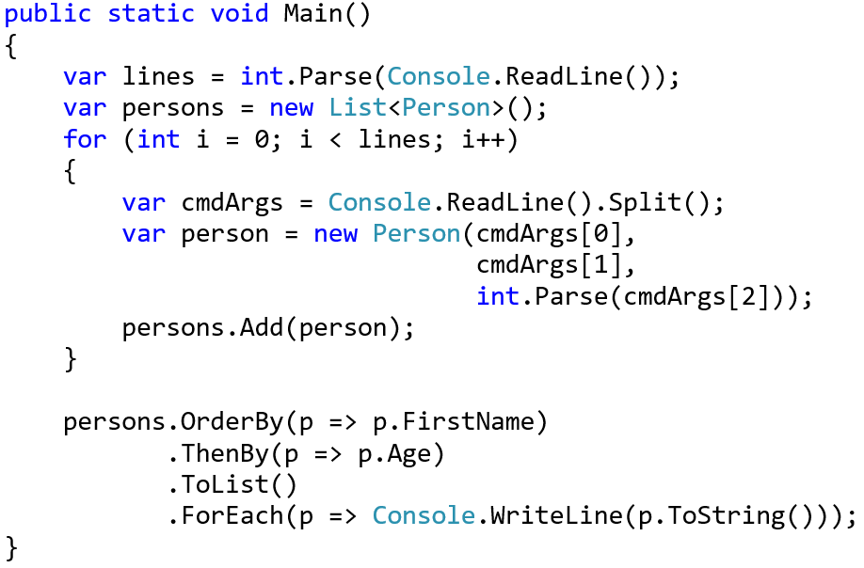
Problem: Sort Persons by Name and Age
Create a class Person
Person
-firstName:string
-lastName:string
-age:int
+FirstName():string
+Age():int
+ТoString():string

Slide 20
Solution: Sort Persons by Name and Age
public class Person {
private string firstName;
private string lastName;
private int age;
public string FirstName => return this.firstName;
public int Age => return this.lastName;
public override string ToString()
{
//TODO: Add logic
}
}

Slide 21
Problem: Salary Increase
Extend Person (add salary)
Add getter for salary
Add method, which updates salary with a given percent
Persons younger than 30 get half of the increase
Person
-firstName : string
-lastName : string
-age : int
-salary : double
+FirstName: string
+Age: int
+Salary: double
+IncreaseSalary(int):void
+ToString(): string

Slide 22
Solution: Salary Increase
Extend the Person class from previous task
private double salary;
public void IncreaseSalary(double percent)
{
if (this.age > 30)
this.salary += this.salary * percent / 100;
else
this.salary += this.salary * percent / 200;
}
Check your solution here: https://judge.softuni.bg/Contests/Practice/Index/475#0

Slide 23

Validation

Slide 24
Validation
Data validation happens in the setters
Users of the class need to handle the exceptions
public double Salary
{
set
{
if (value < 460)
throw new ArgumentException("Salary too low!");
this.salary = value;
}
}
Throw exceptions instead of printing!
Notes:
Constructors are declared public
Constructors perform checks to keep the object state valid
Interface methods are always public
Not explicitly declared with public
Non-interface methods are declared private / protected

Slide 25
Validation (2)
Constructors use private setters with validation logic
Guarantees a valid state for an object when it’s created
public Person(string firstName, string lastName,
int age, double salary)
{
this.FirstName = firstName;
this.LastName = lastName;
this.Age = age;
this.Salary = salary;
}
Validation happens inside of the setter
Notes:
Constructors are declared public
Constructors perform checks to keep the object state valid
Interface methods are always public
Not explicitly declared with public
Non-interface methods are declared private / protected

Slide 26

Problem: Validate Data
Extend Person with validations for every field
Names must be at least 3 symbols
Age cannot be zero or negative
Salary cannot be less than 460
Person
-firstName : String
-lastName : String
-age : Integer
-salary : Double
+Person()
+FirstName(string fname)
+LastName(string lname)
+Age(int age)
+Salary(double salary)

Slide 27
Solution: Validate Data
//TODO: Add validation for firstName
//TODO: Add validation for lastName
public int Age
{
get { return this.age; }
private set
{
if (value < 1)
throw new ArgumentException("Age cannot be negative!");
this.age = value;
}
}
//TODO: Add validation for salary

Slide 28
Immutable Objects
When you have a reference to an instance of an immutable object, the contents of that instance cannot be altered
string myString = "old String"
Console.WriteLine( myString );
myString.ReplaceAll( "old", "new" );
Console.WriteLine( myString );
old String
old String
Notes:
Fields are always declared private
Accessed through getters and setters in read-only or read-write mode
Setters perform checks to fight invalid data

Slide 29
Mutable Objects
When you have a reference to an instance of a mutable object, the contents of that instance can be altered
Point myPoint = new Point(0.0, 0.0);
Console.WriteLine(myPoint);
myPoint.SetLocation(1.0, 0.0);
Console.WriteLine(myPoint);
0.0, 0.0
1.0, 0.0
Notes:
Fields are always declared private
Accessed through getters and setters in read-only or read-write mode
Setters perform checks to fight invalid data

Slide 30
Mutable Fields
private mutable fields are still not encapsulated
class Team {
private String name;
private List<Person> players;
public List<Person> Players
{
get { return this.players; }
}
}
Notes:
Fields are always declared private
Accessed through getters and setters in read-only or read-write mode
Setters perform checks to fight invalid data

Slide 31
Problem: First and Reserve Team
Expand your project with a class Team
Teams have two squads - first team and reserve team
Read persons from the console and add them to the team
If they are younger than 40, they go to the first squad
Print both squad sizes
Team
-name : string
-firstTeam: List<Person>
-reserveTeam: List<Person>
+Team(String name)
+Name(): string
+FirstTeam(): ReadOnlyList<Person>
+ReserveTeam: ReadOnlyList<Person>
+AddPlayer(Person person)

Slide 32
Solution: First and Reserve Team
private string name;
private List<Person> firstTeam;
private List<Person> reserveTeam;
public Team(string name)
{
this.name = name;
this.firstTeam = new List<Person>();
this.reserveTeam = new List<Person>();
}

Slide 33
Solution: First and Reserve Team
public IReadOnlyCollection<Person> FirstTeam
{
get { return this.firstTeam.AsReadOnly(); }
}
//TODO: add getter for reserve team
public void AddPlayer(Person player)
{
if (player.Age < 40)
firstTeam.Add(player);
else
reserveTeam.Add(player);
}

Slide 34


Encapsulation – Benefits
Reduces complexity
Structural changes remain local
Allows validations and data binding
Notes:
Ensures that structural changes remain local
Changing the class internals does not break any outside code
Allows changing the internal class implementation

Slide 35
Summary
Fields in classes should be private and accessed only through properties
Access modifiers
Encapsulation
Hides implementation
Reduces complexity
Ensures that structural changes remain local
Mutable and Immutable Objects

Slide 36







Encapsulation and Validation
https://softuni.bg/courses/databases-advanced-entity-framework

Slide 37





Trainings @ Software University (SoftUni)
Software University – High-Quality Education, Profession and Job for Software Developers
softuni.bg
Software University Foundation
http://softuni.foundation/
Software University @ Facebook
facebook.com/SoftwareUniversity
Software University Forums
forum.softuni.bg

